Slide 1
Chapter 25
Understanding XML Web Services

Slide 2
Objectives
XML Web Services
How to build XML Web Services
Discovery Services (UDDI and DISCO)
Web Service Description Language (WSDL)
Simple Object Access Protocol (SOAP)
Using Web Services

Slide 3
Content
The role of XML Web Services
Building an Web Service
Understanding the [WebService] attribute
Understanding the [WebServiceBinding] attribute
Understanding the [WebMethod] attribute
Exploring the Web Service Description Language (WSDL)
Revisiting the XML Web Service wire protocols
Consuming an Web Service

Slide 4
The role of XML Web Services
An XML web service as a unit of code that can be invoked via HTTP requests
An XML web service often exposes the same sort of functionality found in a standard .NET code library
Benefits of XML Web Services
  XML web services allow you to invoke methods and properties of a remote object using standard HTTP requests
  XML web services provide a way for unrelated platforms, operating systems, and programming languages to exchange information in harmony
    Information is passed between systems via XML data representation

Slide 5
The role of XML Web Services
Defining an XML Web Service client
  The XML web service consumer indirectly interacts with the distant XML web service through an intervening proxy type
  An XML web service proxy looks and feels like the actual remote object and exposes the same set of members
    Forwards requests to the XML web service using standard HTTP
    Maps the incoming stream of XML back into .NET-specific data types

Slide 6
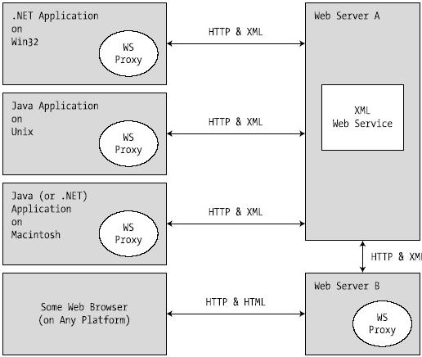
The role of XML Web Services
Defining an XML Web Service Client

Slide 7
The role of XML Web Services
The Building blocks of an XML Web Service
  An XML web service involves the following core technologies:
    A discovery service (so clients can resolve the location of the XML web service).
    A description service (so clients know what the XML web service can do)
    A transport protocol (to pass the information between the client and the XML web service)

Slide 8
The role of XML Web Services
Previewing XML Web Service Discovery
  To share the functionality of web service, register XML web service with a Universal Description, Discovery, and Integration (UDDI) server
  UDDI is the white pages for XML web services
  Clients use UDDI catalog or Discovery of Web Services (DISCO) to locate Web services

Slide 9
The role of XML Web Services
Previewing XML Web Service Description
  The client must fully understand the exposed functionality before invoking methods.
  Use XML-based metadata to describe a XML web service is termed the Web Service Description Language (WSDL).
    WSDL will be automatically generated by Microsoft IIS when the incoming request has a ?wsdl suffix.
    Take a “WSDL first” approach and begin building web services by defining the WSDL document manually
  Use wsdl.exe to generate proxy type for an XML web service based on a WSDL definition

Slide 10
The role of XML Web Services
Previewing the Transport Protocol
  Use HTTP GET, HTTP POST, or SOAP to move information between consumers and web services
  SOAP messages can contain XML descriptions of complex types (including your custom types as well as types within the .NET base class libraries)
  using the HTTP GET or HTTP POST protocols is restricted to a more limited set of core data XML schema types

Slide 11
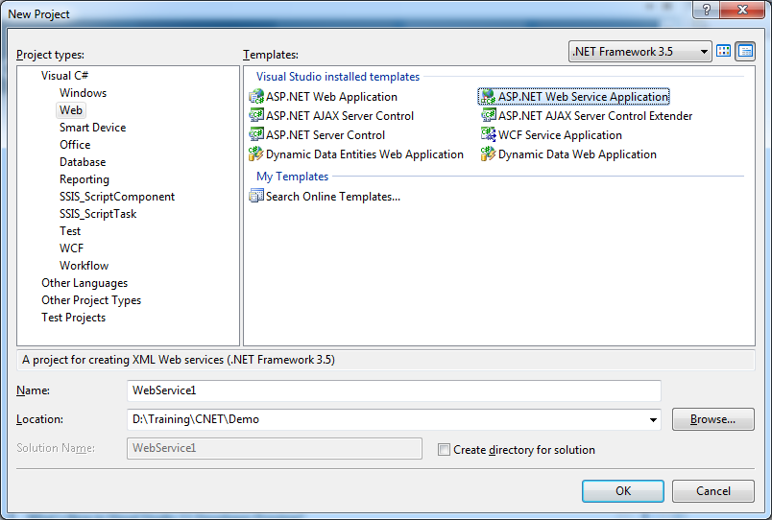
Building an XML Web Service

Slide 12
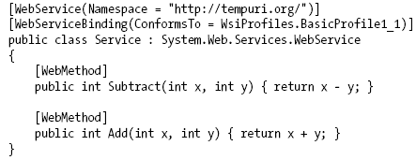
Understanding the [WebService] attribute
An XML web service class may optionally be qualified using the [WebService] attribute

Slide 13
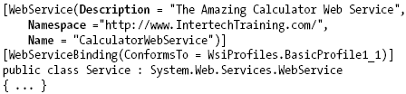
Understanding the [WebService] attribute
The Name property
  Is used to establish the name of the XML web service exposed to the outside world
  By default, the external name of a web service is identical to the name of the class type itself

Slide 14
Understanding the [WebServiceBinding] attribute
Used to specify if the XML web service conforms to “Web services interoperability (WSI) basic profile 1.1”
By default, XML web services are assumed to conform to the WSI basic profile 1.1

Slide 15
Understanding the [WebServiceBinding] attribute
Ignoring BP 1.1 conformance verification
[WebServiceBinding(ConformsTo = WsiProfiles.None ,
EmitConformanceClaims = false)]
Disabling BP 1.1 conformance verification
Notes:
<configuration>
<system.web>
<webServices>
<conformanceWarnings>
<remove name='BasicProfile1_1'/>
</conformanceWarnings>
</webServices>
</system.web>
</configuration>

Slide 16
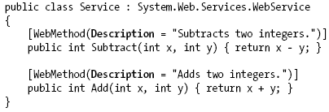
Understanding the [WebMethod] attribute
Applied to each method to be exposed from an XML web service
Documenting a Web method via the Description property

Slide 17
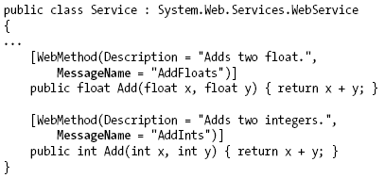
Understanding the [WebMethod] attribute
Avoiding WSDL name clashes via the MessageName property

Slide 18
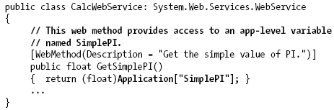
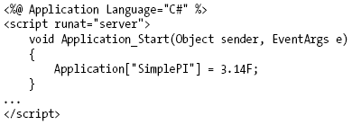
Understanding the [WebMethod] attribute
Building stateful Web Services via the EnableSession property

Slide 19
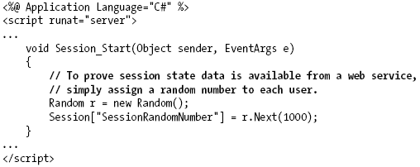
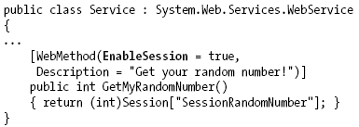
Understanding the [WebMethod] attribute
Building stateful Web Services via the EnableSession property

Slide 20
Exploring the Web Service Description Language
(WSDL)
WSDL is used to describe the following characteristics for each exposed web method:
  The name of the XML web methods
  The number of, type of, and ordering of parameters (if any)
  The type of return value (if any)
  The HTTP GET, HTTP POST, and SOAP calling conventions

Slide 21
Exploring the Web Service Description Language
(WSDL)
In most cases, WSDL documents are generated automatically by web server
  For in-house XML web services, the WSDL generated by your XML web server will be sufficient most of the time
It is also possible to begin an XML web service project by authoring the WSDL document by hand

Slide 22
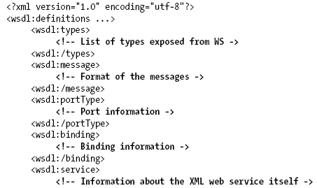

Exploring the Web Service Description Language
(WSDL)
Defining a WSDL document

Slide 23
Exploring the Web Service Description Language
(WSDL)
The <types> Element
  Contains descriptions of any and all data types exposed from the web service
  XML itself defines a number of “core” data types (http://www.w3.org/2001/XMLSchema)

Slide 24
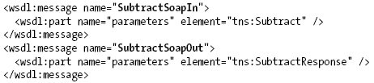
Exploring the Web Service Description Language
(WSDL)
The <message> Element
  Used to define the format of the request and response exchange for a given web method
  It is permissible for a single WSDL document to define multiple <message> elements which are transmitted between the sender and receiver
  <message> tend to occur in pairs

Slide 25
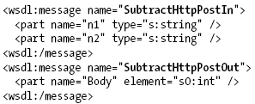
Exploring the Web Service Description Language
(WSDL)
To HTTP POST bindings, the generated WSDL show the following <message> data:
If a web method is a one-way method, then it only is necessary a request <message> element of which method can be marked by applying the [SoapDocumentMethod] attribute

Slide 26
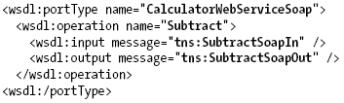
Exploring the Web Service Description Language
(WSDL)
The <portType> Element
  Defines the characteristics of the various correspondences that can occur between the client and server, each of which is represented by an <operation> subelement
  The one-way and the solicit/response operation

Slide 27
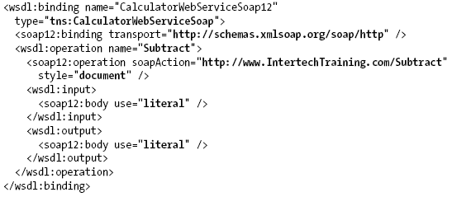
Exploring the Web Service Description Language
(WSDL)
The <binding> Element
  Specifies the exact format of the HTTP GET, HTTP POST, and SOAP exchanges

Slide 28
Exploring the Web Service Description Language
(WSDL)
The <service> Element
  Specifies the characteristics of the web service itself (such as its URL)
  The chief duty of this element is to describe the set of ports exposed from a given web server
  The <services> element makes use of any number of <port> subelements

Slide 29
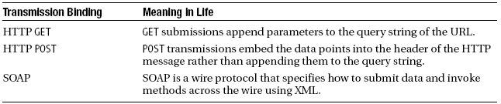
Revisiting the XML Web Service wire protocols
XML web services can use any RPC protocol to facilitate communication (such as DCOM or CORBA)
However, most web servers bundle this data into the body of an HTTP request and transmits it to the consumer using one of three core bindings:

Slide 30
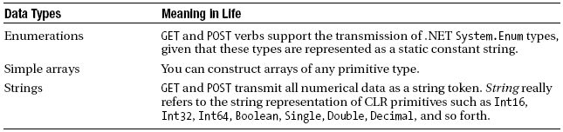
Revisiting the XML Web Service wire protocols
HTTP GET and HTTP POST Bindings
  Not rich enough to represent such complex items as structures or classes
  Supported POST and GET Data Types

Slide 31
Revisiting the XML Web Service wire protocols
SOAP Bindings
  SOAP itself does not define a specific protocol and can thus be used with any number of existing Internet protocols (HTTP, SMTP, and others)
  Provide a mechanism to invoke methods using complex types in a language- and platform-neutral manner
  A SOAP message defines two core sections:
    the SOAP envelope: understood as the conceptual container for the relevant information.
    The rules that are used to describe the information in said message (placed into the SOAP body)
    An optional third section (the SOAP header) may be used to specify general information regarding the message itself, such as security or transactional information

Slide 32
Revisiting the XML Web Service wire protocols
The wsdl.exe Command-Line utility
  Performs two major tasks:
    Generates a server-side file that functions as a skeleton for implementing an XML web service
    Generates a client-side file that functions as the proxy to a remote XML web service
  Supports a number of command-line flags

Slide 33
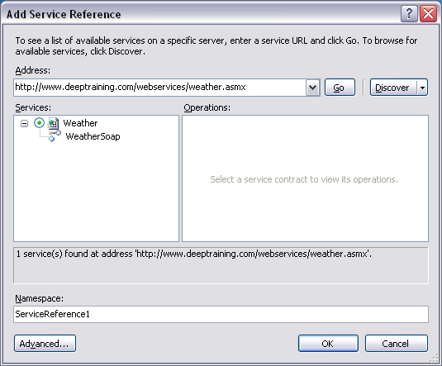
Consuming an Web Service
Use Add Web Reference or Add Service Reference dialog to generate a proxy file

Slide 34
Summary
The core building blocks of .NET web services
The [WebMethod] attribute
Lookup mechanism (UDDI)
Description Language (WSDL)
Wire protocol (GET, POST, or SOAP)

Slide 35
Q & A

